Slide 1






Ethics and Regulations
of Fintech
Workshop
28th February 2018
/UoGfintech
@UoGfintech
@uogfintech
UoG FinTech Society

Slide 2



Our Team
Neil Kennedy
Giulia Carfora
MSc Software Development
MSci Mathematics
Elisabetta Trasatti
Heli Trivedi
MSc Banking and Financial Services
M.A. Economics

Slide 3
1
Fintech regulations
2
Ethical use of personal data
3
4
Use of Cryptocurrencies in Illegal Activities
Open Banking

Slide 4
Fintech Regulations - Approaches
01
Active approach
Regulators work closely with start-ups to understand new FinTech developments and upcoming obstacles and to help start-ups to address these challenges.
Passive approach
02
National regulators do not play an active role in trying to make FinTechs succeed, but they don’t stand in their way either.
03
Restrictive approach
Governments can take this approach because they are risk averse.

Slide 5
Fintech Regulations
RegTech
A blend word of 'regulatory technology' that was created to address regulatory challenges in the financial services sector through innovative technology
Realistic, effective regulation required
Regulation challenges

Slide 6
1
Fintech Regulations
2
Ethical use of Personal Data
3
4
Use of Cryptocurrencies in Illegal Activities
Open Banking

Slide 7
Customer Data Security
What is data and why is it important?
Data is essentially another word for information.
The financial sector handles an enormous amount of information about customers and enterprises.
According to research, Internet users generate an average of 2.5 quintillion bytes of data everyday.
Data has become such a valuable asset that it is often called “the currency of the future”

Slide 8

Issues with Data
Data security and data ubiquity are proving to be major challenges for Fintech.
Data includes Personally Identifiable Information (PII) and is susceptible to security breaches.
Protection of data is a key issue in Fintech today.

Slide 9
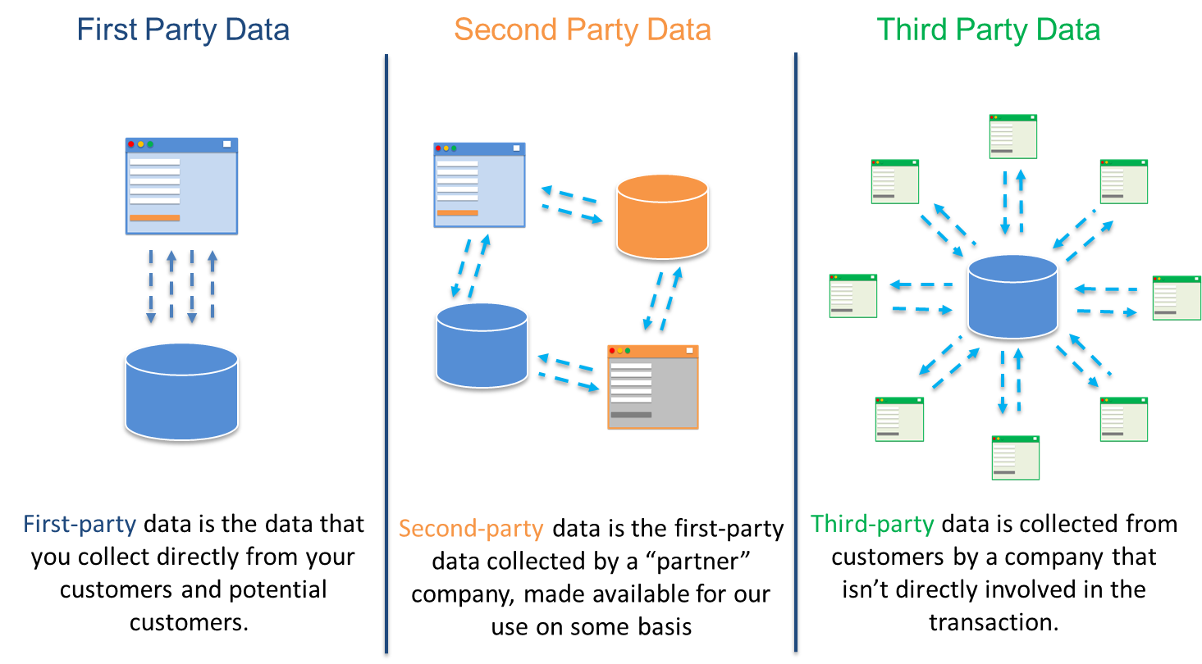
Different types of Data

Slide 10
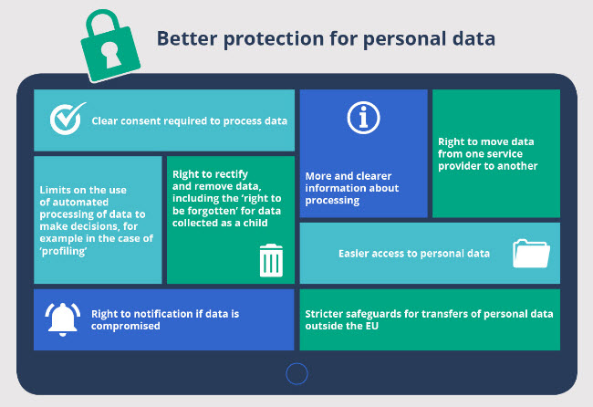
General Data Protection Regulation
As data protection standards become increasingly high, companies face the more complex task to evaluate whether their data processing activities are legally compliant.
In this context, the European Union decided to adopt the General Data Protection Regulation, which will enter into force on 25 May 2018.

Slide 11
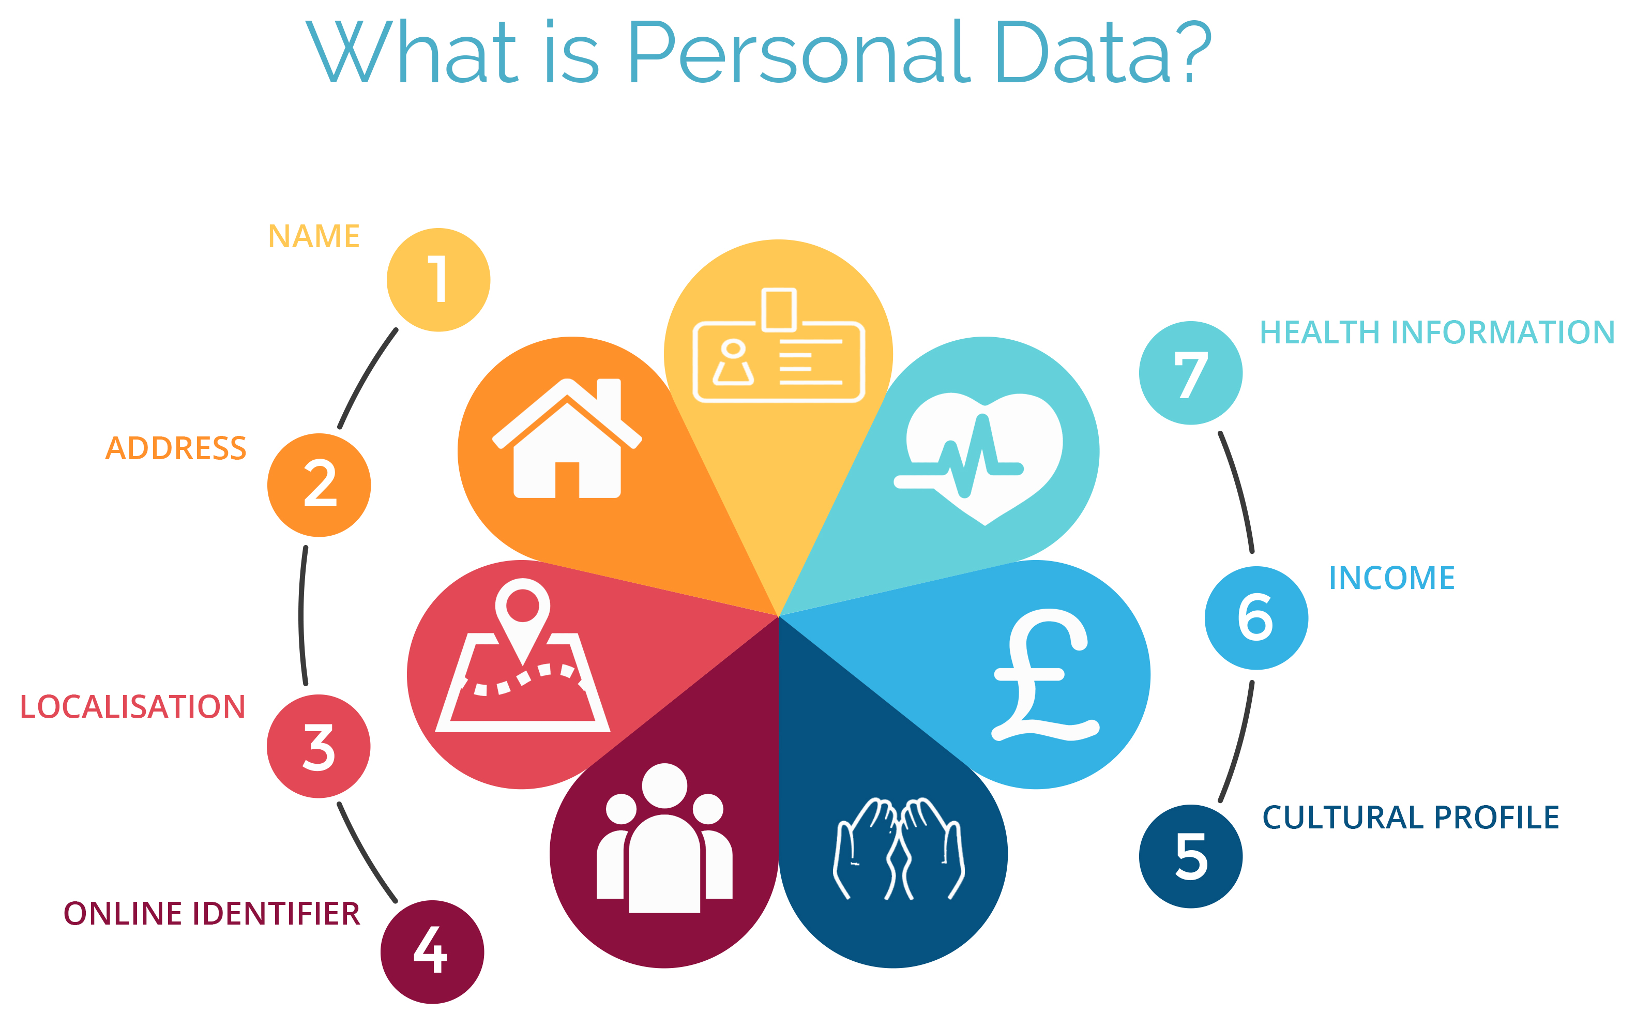
What is Personal Data?

Slide 12
A comparison with the U.S.
The U.S. doesn’t apply the same 'citizen first' approach to issues concerning data but there two key federal laws which prevent “unfair and deceptive practices” and make sure children’s data is protected properly.
In the U.S., the First Amendment of the Constitution protects freedom of expression, including the right of an individual to speak freely. Therefore, there is no rule allowing people to delete or remove negative information about themselves online.
In case of a breach, notification requirements vary. Financial companies are required to warn customers as soon as possible if there is the risk of misuse of personal information, though companies might delay these disclosures if they could interfere with a criminal investigation.
There is no single federal law or standard people can rely on to obtain copies of their records, but there are industry-specific rules.
Notes:
Add your own dates and event details to the flag markers. Move the flags along the timeline to match your event dates. Copy and paste a flag to add more.

Slide 13
1
Fintech Regulations
2
Ethical use of Personal Data
3
4
Use of Cryptocurrencies in Illegal Activities
Open Banking

Slide 14
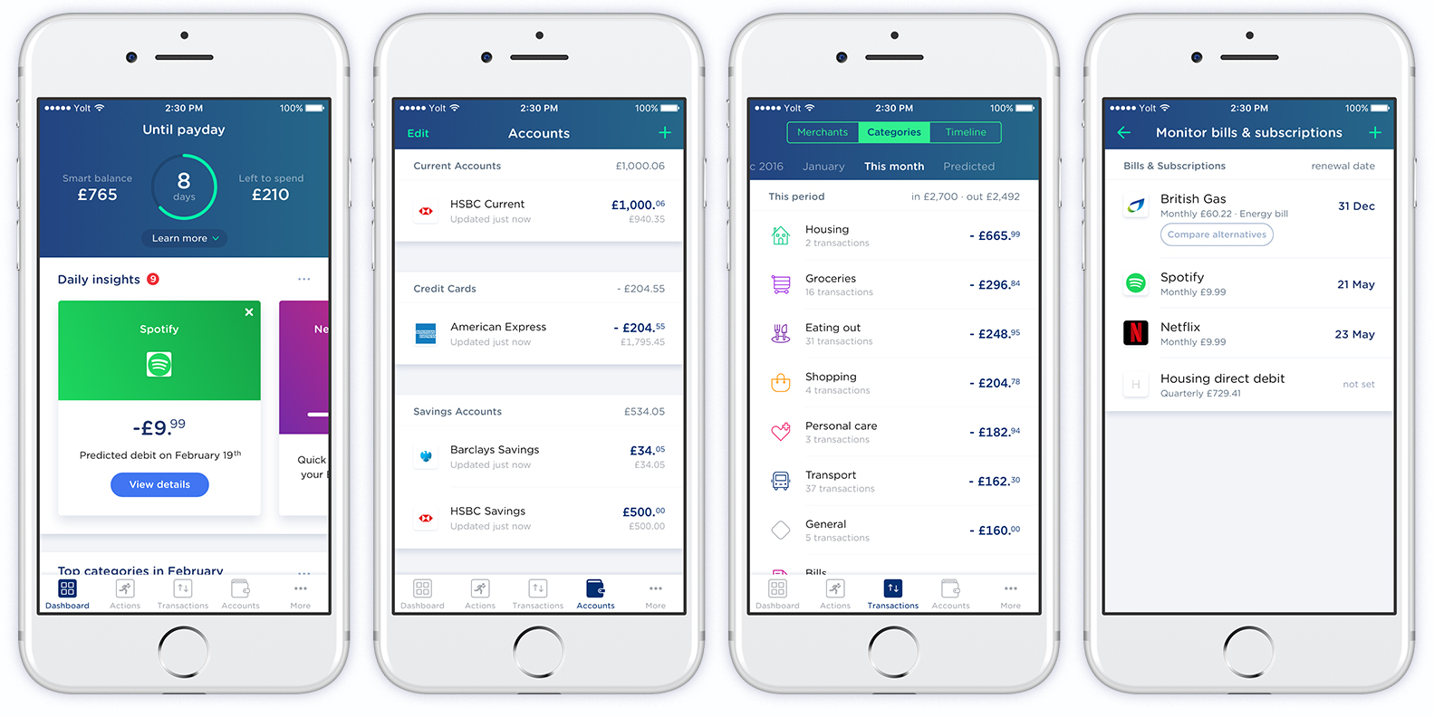
Open Banking
Opening up banking data – allowing 3rd parties to build new products

Slide 15
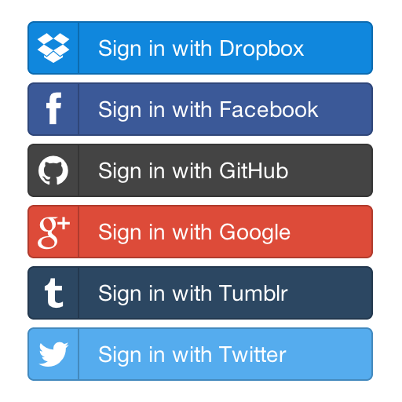
APIs
APIs Power Open Banking
An API allows one piece of software to access the data or functionality of another
APIs are the backbone of many internet features we take for granted
Sharing data is a technological challenge for banks

Slide 16

The Problem
Large legacy banks have a fragmented data architecture
The systems are old and bulky, with multiple duplicates and no reliable master data source
To facilitate Open Banking, banks have to overhaul their backend systems and create ”Golden” sources

Slide 17
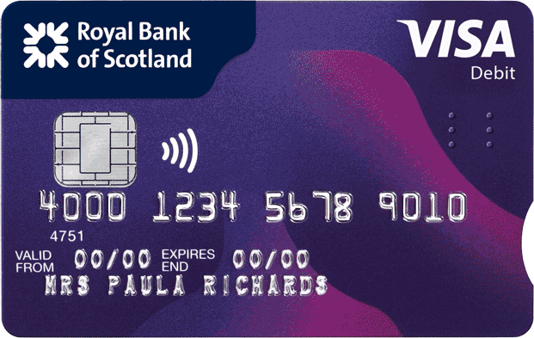
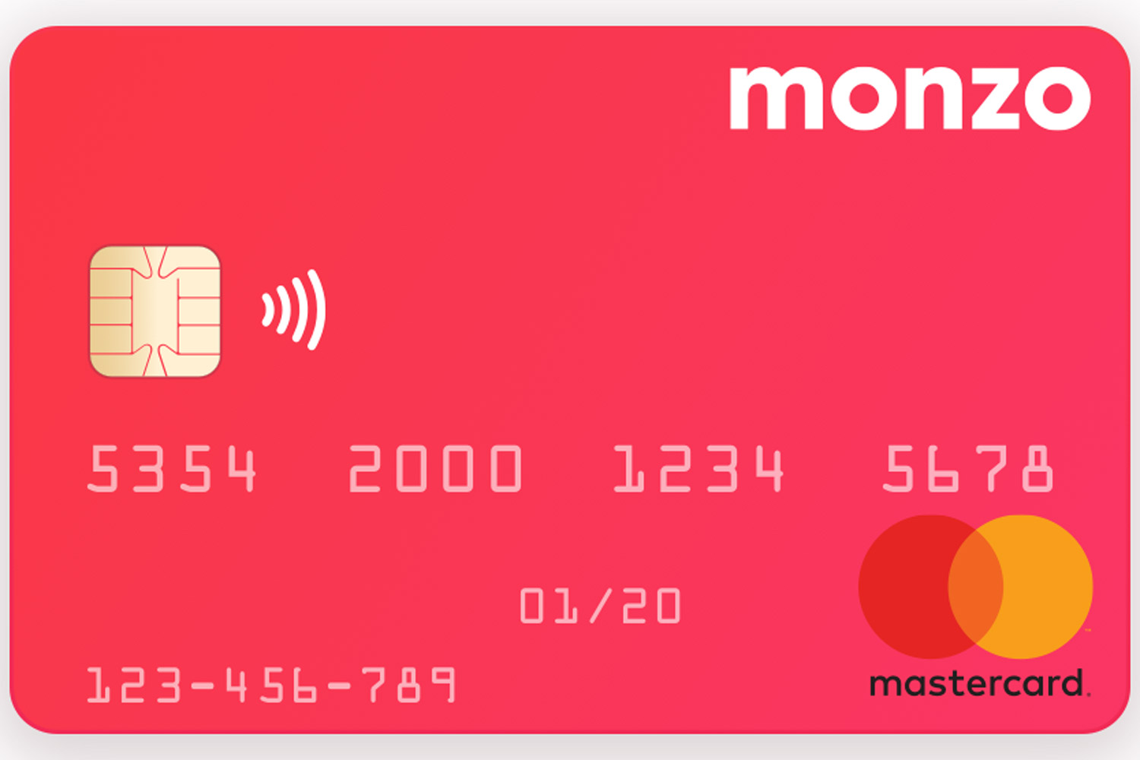
Architectures – A Comparison
Payment appears in statement a few days after
Very little data is captured (e.g. amount, vendor, date)
Payment takes seconds to show in app
Much richer data is captured (e.g. location, automatic categorisation)
Incumbent
Challenger

Slide 18
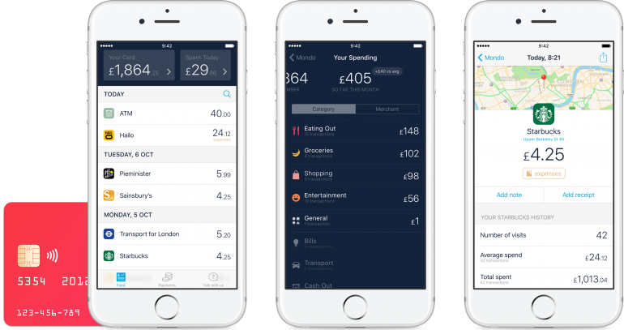

Slide 19

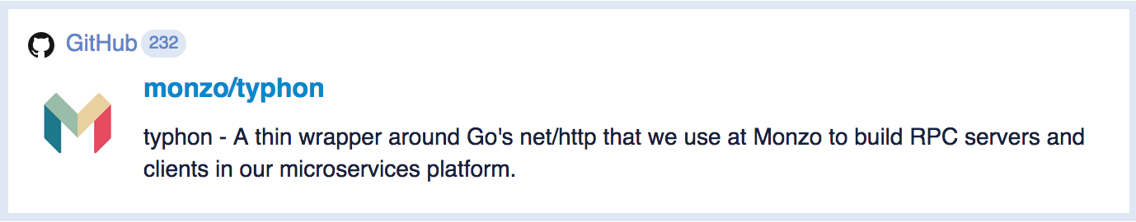

Active Development Community
Innovative Architecture

Slide 20
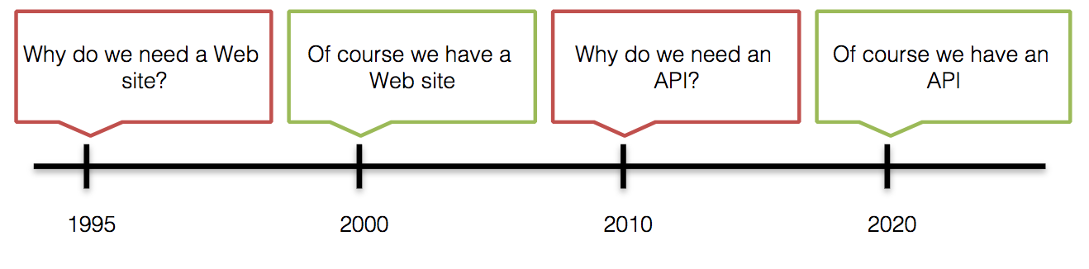
Banking Is Changing
Open Banking is an agent of change. Large, legacy banks need to overhaul how they manage technological change or their core business functions may be at risk.
From individual lenders to marketplace lending
Institutional investors

Slide 21
1
Fintech Regulations
2
Ethical use of Personal Data
3
4
Use of Cryptocurrencies in Illegal Activities
Open Banking

Slide 22
Anonymity factor
Benefits
Risks
"no single point of failure"
More freedom to trade and move financial capital
Privacy
Facilitation of Illegal Activities
"Nations make currencies, but they like to have central banks controlling them. They like to know who has it, where it is going and why it is going there.”
(Jamie Dimon, CEO of JPMorgan Chase bank)
New hardware makes virtual reality games smoother and more life-like as popularity skyrockets

Slide 23
Silk Road
Illegal marketplace
“Truly free market”
Anonymity ensured to drug dealers by the use of Tor.
Rapid transactions across international borders among anyone who has Internet access.

Slide 24
After the Silk Road scandal (US)
NYDFS issues Bitlicense (2015)
Virtual currency services called to safeguard themselves from exploitation by criminals and terrorists.
OUR TEAM
INTRODUCTION
PORTFOLIO
https://cointelegraph.com/news/cryptocurrency-regulation-in-the-international-community-2015-part-2

Slide 25
Towards more Privacy and Untraceability
Private
Amounts, origins and destinations of the transactions are obfuscated by ring signatures.
Untraceable
Monero transactions cannot be linked to a particular IP address.
New cryptocurrencies have overcome the potential traceability of Bitcoin.

Slide 26
https://www.bleepingcomputer.com/news/cryptocurrency/litecoin-not-monero-is-the-second-most-dominant-dark-web-currency/

Slide 27
Main Concerns for Regulators
international collaboration
Balance of
Security & Innovation
Create a global agreement
Need of a Facilitative Framework

Slide 28

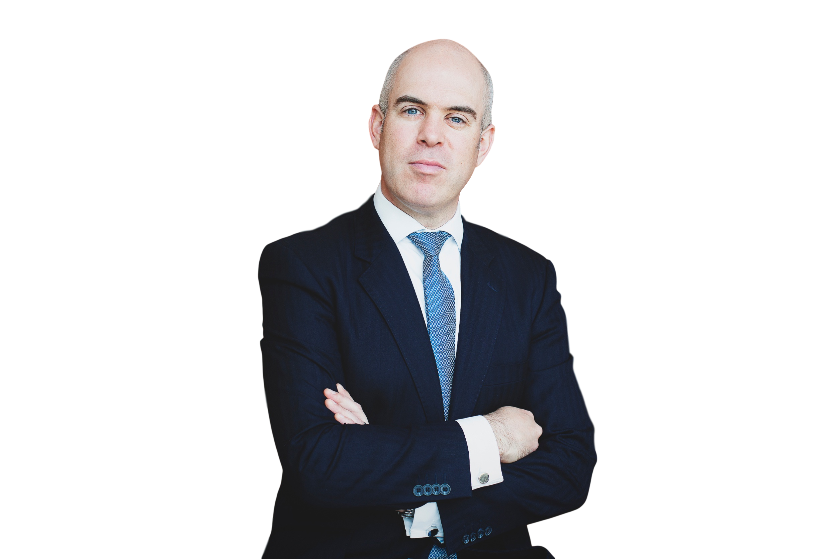


Glasgow University
FinTech Society
The Ethics & Regulation of FinTech
28 Feb 2018, 5:30-7pm Boyd Orr Building, room 611 E, Glasgow University
Topics covered at the workshop:
» Guest speaker
Fintech Regulations
Ethical use of Personal Data & GDPR
Burness Paull is a top tier Scottish commercial law firm.
David Goodbrand
Partner - Commercial Division
Open Banking
Charles Rogers
Senior Solicitor - Financial
Services Regulatory
Regulations on illegal activities with the use of cryptocurrencies
UoG FinTech Society | @UoGfintech | info@uogfintech.com | www.uogfintech.com

Slide 29
GDPR – The Final countdown for Fintech…
David Goodbrand, Partner, Technology and Commercial
28 february 2018

Slide 30


Slide 31
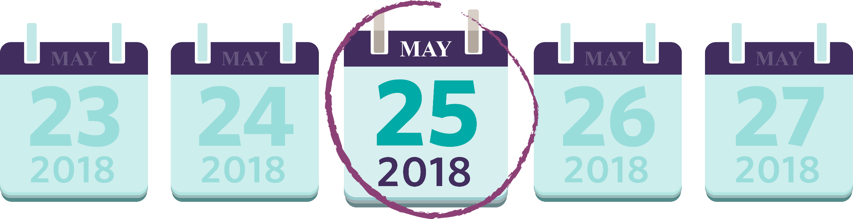

Slide 32
Key Headlines
General Data Protection Regulation (GDPR) replaces the Data Protection Act 1998.
Builds on DPA, but creates new obligations for data controllers and data processors.
Fines of up to 4% of annual worldwide turnover or €20 million whichever is highest.
Brexit will not impact roll out of GDPR.

Slide 33
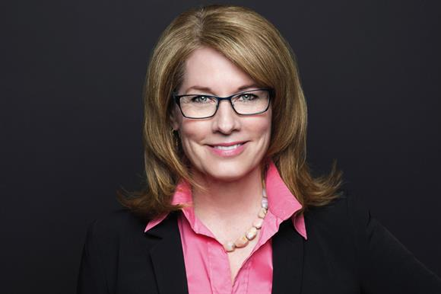
Elizabeth Denham - HEAD OF ICO 2 FEBRUARY 2018
“personal data is the fuel that powers so much of what makes our economy, our home life, our public services function.”
“GDPR rebalances the relationship between individuals and organisations.”
“compels organisations to be transparent and account for their actions.”
“opportunity to commit to data protection and embed in your policies, processes and people.”
“when I speak to the private sector I can sense panic, but also the incentive to get it right”.
“we’re expecting more of everything”.
“I’ll be honest – we’re still figuring out how we’re going to carry out some of our functions.”

Slide 34
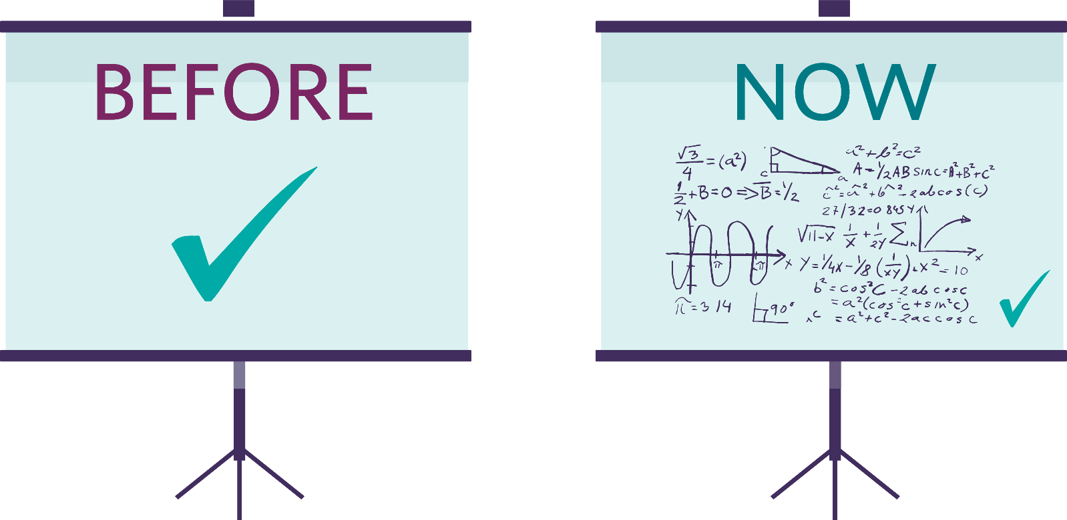
Accountability

Slide 35
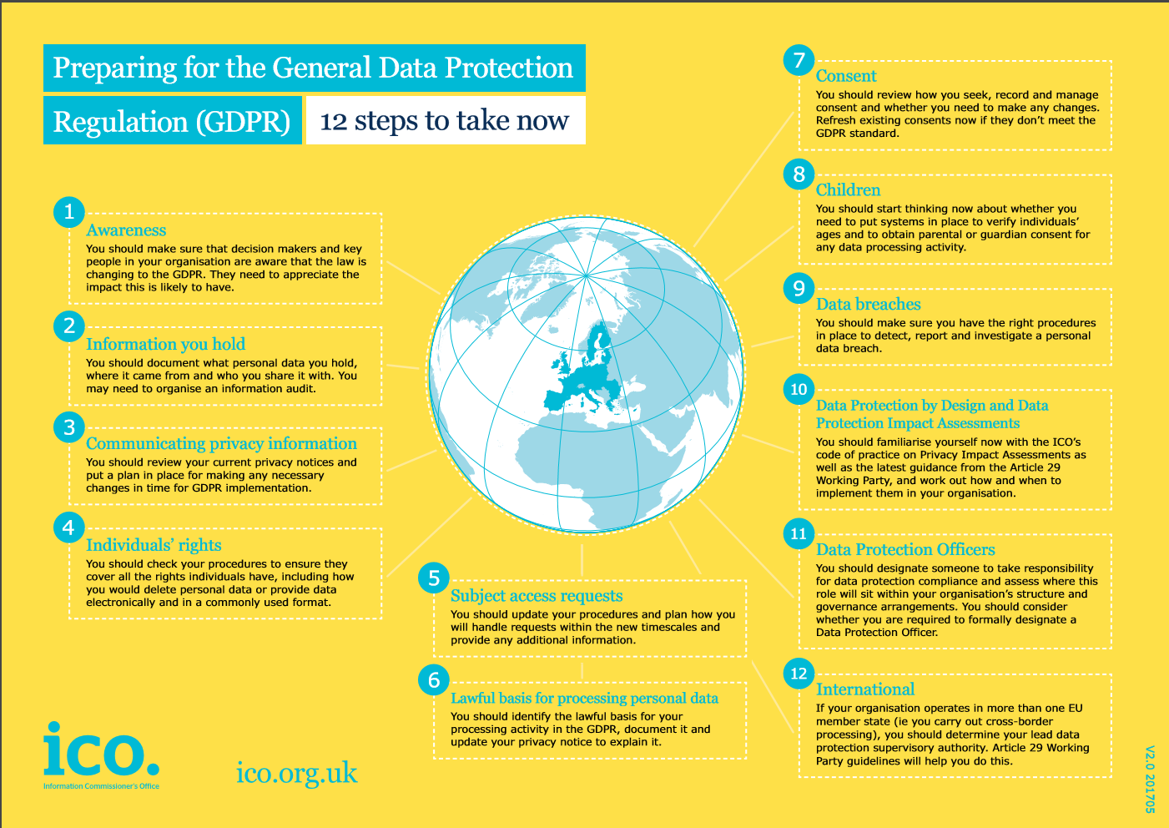

Slide 36
TOP FIVE THINGS THAT FINTECH START-UPS SHOULD KNOW ABOUT FINANCIAL SERVICES REGULATION

Slide 37
HOW DOES FINANCIAL SERVICES REGULATION WORK IN THE UK?
Key is the ‘general prohibition’ – that a person (which includes business entities as well as individuals) must not carry on a regulated activity in the UK, or purport to do so, unless they are an authorised or exempt person
Carrying on a regulated activity in breach of the general prohibition is a criminal offence and may result in certain agreements being unenforceable

Slide 38
WHAT ARE REGULATED ACTIVITIES?
An activity is regulated if it’s of a specified kind and relates to a specified investment (some examples of these are below)
If you’re carrying out a regulated activity in the UK by way of business then you either need to be authorised or otherwise exempt

Slide 39
WHAT ARE REGULATED ACTIVITIES?
Regulated activities include: | Specified investments include:
accepting deposits issuing e-money carrying out or helping to administer insurance contracts (as a firm's principal) investments: dealing in or managing (as a principal or agent), arranging deals, safeguarding and administering, advising home finance: arranging, advising on, entering into and administering operating a multilateral trading facility sending dematerialised instructions (electronic transfer of title in investments like securities and contractually-based investments) setting up collective investment schemes setting up stakeholder pensions schemes providing basic advice on stakeholder products Lloyd’s market activities entering funeral plan contracts | deposits e-money rights under an insurance contract shares instruments creating or acknowledging indebtedness sukuk (sharia compliant debt instruments) government and public securities instruments giving entitlement to investments certificates representing some securities units in a collective investment scheme rights under a stakeholder pension scheme rights under a personal pension scheme options futures contracts for differences Lloyd's syndicate capacity and syndicate membership

Slide 40
HOW DO I BECOME AUTHORISED?
You’ll need to apply to the Financial Conduct Authority (FCA) to become authorised and can find out more about this on the FCA’s website: https://www.fca.org.uk/firms/authorisation/apply-authorisation
The process is different for dual-regulated firms, such as a banks, credit unions and insurance firms, who apply to the Prudential Regulation Authority

Slide 41
WHAT ARE MY ALTERNATIVES TO BECOMING AUTHORISED?
Appointed representative (AR) | Introducer
The main way to carry out regulated activities without needing to be authorised is becoming an AR – you would act as an agent for an authorised firm known as the ‘principal’ The principal would take full responsibility for seeing that you comply with the FCA’s rules You’ll need to enter into a compliant agreement with the principal | You can introduce clients to a person permitted to carry on the activity of making arrangements in order for the client to gain independent advice (and as long as the arrangements do not relate to a contract of insurance) There’s a more restrictive exemption for introducing clients for advice on insurance agreements, including accounting to the client for any commission received

Slide 42
WHERE CAN I GET FURTHER GENERAL GUIDANCE ON FINANCIAL SERVICES REGULATION?
The regulator’s website (https://www.fca.org.uk/firms) is a great source of info
The FCA also engages directly with start-ups in a number of ways through Project Innovate, including direct support and the regulatory sandbox

Slide 43
WHERE CAN I GET FURTHER GENERAL GUIDANCE ON FINANCIAL SERVICES REGULATION?
Direct support | Regulatory sandbox
Where a new market entrant meets the FCA’s criteria, it will provide a variety of support for queries including informal steers The eligibility criteria are that the business is genuinely innovative, provides consumer benefit, requires support and has done it’s homework before approaching the FCA | The sandbox is a way for innovative firms to road-test their business with real customers in a controlled environment with close monitoring by the regulator The entry criteria are that the firm is in scope, genuinely innovative, provides consumer benefit, needs to use the sandbox and is ready to test

Slide 45
David Goodbrand
Charles Rogers
partner
Senior solicitor
0131 473 6125
07802 933272
david.goodbrand@burnesspaull.com
0131 473 6112
07969 797 014
charles.rogers@burnesspaull.com

